Slide 1
Kasten K10
#1 Kubernetes Backup
Gaurav Rishi
July 2021
VEEAM INTERNAL DOCUMENT

Slide 2




Market Growth: Secular Trends
Hybrid Clouds
Infra Transformation
Enterprise customers having a multi- and hybrid-cloud footprint
Kubernetes: available everywhere, increased production usage
Stateful Applications
Increased production usage and demand seen from events, customers, analysts

Slide 3



Kasten K10 Use Cases
Backup and Restore
Disaster Recovery
Application Mobility
Multi-tenancy, RBAC, Scale, Performance, Polyglot Persistence
Cross-AZ and Region, Multi and Hybrid Cloud,
Storage Transforms
Cluster Upgrades, Application Transforms, Test/Dev Clusters

Slide 4




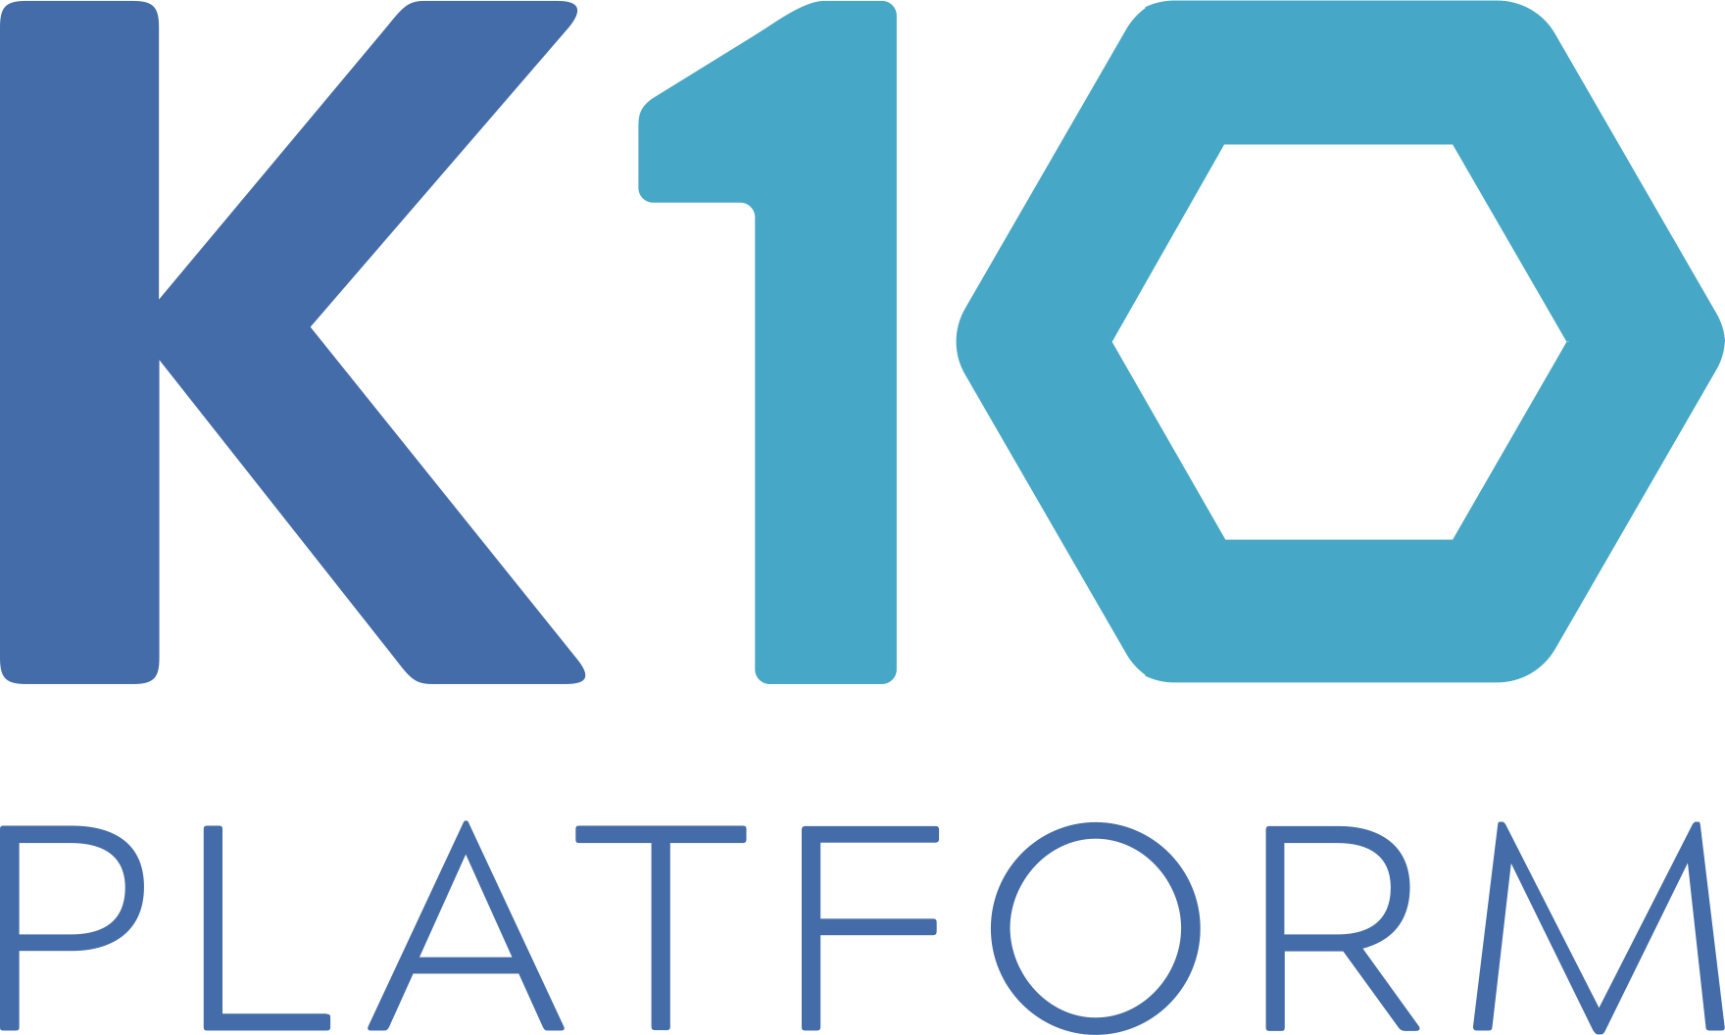










Kasten K10 Architecture a High-level Overview
1
Orchestrator APIs
Uses Kubernetes API to discover applications and underlying components and perform lifecycle operations.
K10-Protected Applications
Application
Blueprint
Application
Blueprint
2
Infrastructure APIs
3
3
No proprietary storage layer. Minimal integration with infrastructure specific APIs for the following:
Block storage provider - Snapshot functionality, snapshot and block copy
Object/file provider - S3-compatible object store or other file storage like NFS for artifacts
Cloud Native App
Cloud Native App
Lift-and-Shift App
Lift-and-Shift App
Cloud Native App
Cloud Native App
Cloud Native App
Cloud Native App
1
Container Orchestration Platform
2
3
Application Framework
Virtual or Physical Infrastructure
Optional agentless application-centric hooks can be invoked by easy-to-use blueprints

Slide 5



Kubernetes backup, dr, and mobility Kasten K10 unique capabilities
Kubernetes-native
Multi-layered consistency
Simplicity
Security – K8s RBAC
Cloud-native monitoring, logging
Wide Spectrum: App/DB/System
DB Level tools, Storage level w/ CBT
Extensibility to define workflows
Freedom of choice
DevOps speed and scale
Multiple K8s Distro, Storage, DB
Flexible deployments – Cloud/OnPrem
Dynamic Transforms – App mobility
Secure multi-cluster, self-service
Optimized CPU & Memory w/serverless Throughput & Space efficiencies

Slide 6



Kasten K10 Kubernetes-native
Simplicity
Security
Native CLI + K8s APIs
Kubernetes CRDs
Easy to use dashboard
Encryption with CMKs
Immutable object storage
No priv daemonsets required
RBAC + OIDC + Token Support
Cloud-Native Monitoring, Logging
Integrations with Prometheus, Grafana,..
Rich dashboard data – coverage, storage use, ..

Slide 7



Kasten K10 Multi-layered consistency
Consistency Spectrum
DB Level
Application consistent
Database consistent
System consistent
Relational/NoSQL support
Logical Dataservices tools
Native integrations
Workflow Extensibility
Predefined blueprints for common app patterns
Easy to extend/author blueprints with hook ext.

Slide 8


Kasten K10 DevOps Speed and Scale
Self-Service
Optimized CPU & Memory
Multi-tenant and multi-cluster
Local and global protection policies
DevSecOps w/forward looking policies
Next-Gen Data Engine – dynamic scale
Parallel data transfers, lock-free algos
Pluggable encryption and compression
Throughput and Space Efficiencies
Up to 4X space efficiency on backups
3-5X Throughput improvements
Smaller fault domains

Slide 9
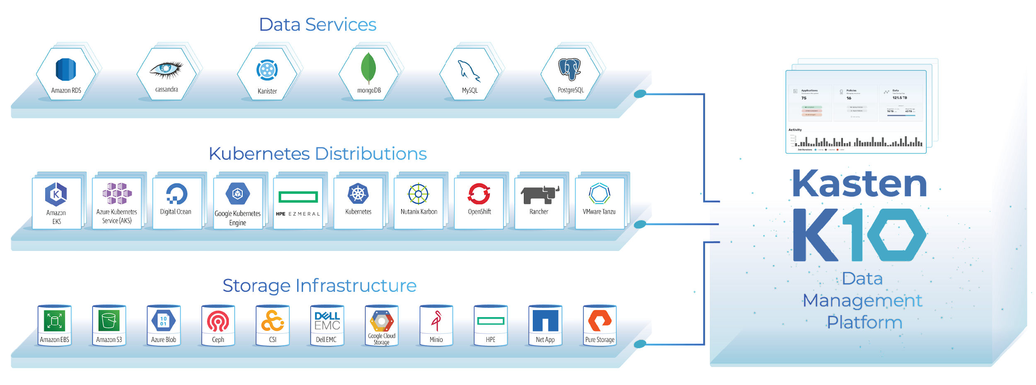
Kasten K10 capabilities freedom of choice
Widest ecosystem integrations with dynamic transforms
Notes:
Dashb

Slide 10

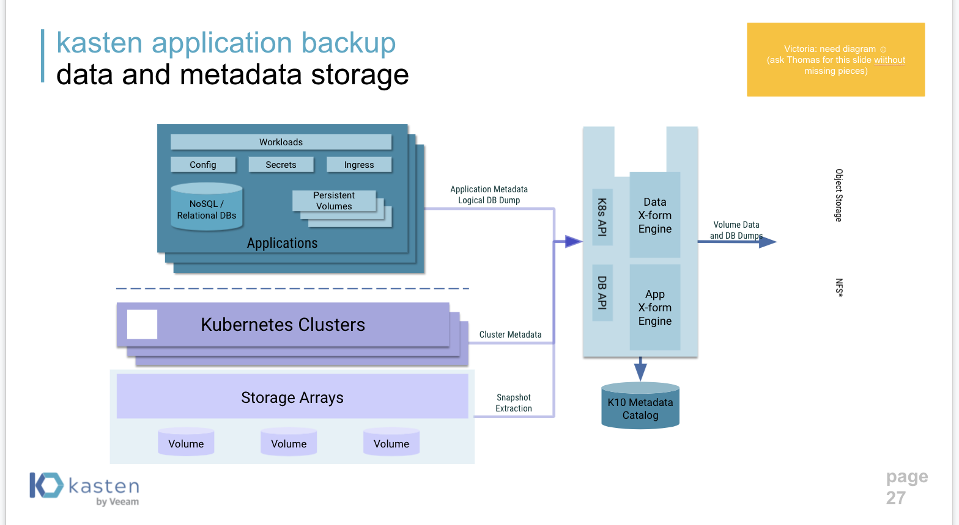
Kasten Application Backup Data and Metadata Storage
Workloads
Config
Secrets
Ingress
Data X-form Engine
Persistent Volumes
Application Metadata Logical DB Dump
NoSQL /
Relational DBs
K8s API
Volume Data
and DB Dumps
Object Storage
VBR Server
Applications
App X-form Engine
DB API
NFS
Kubernetes Clusters
Cluster Metadata
Kubernetes Clusters
Kubernetes Clusters
Storage Arrays
Snapshot
Extraction
K10 Metadata Catalog
Volume
Volume
Volume

Slide 11


































SELECTED FEATURES
Data Operations
Metadata Operations
Backup, DR, Mobility
Ops Support
Volume Snapshots
Auto App Discovery
Policy-based Operations
Enterprise Dashboard
Durable Backups
Full Spec Capture
Manual Actions
API-first Design
Change Block Tracking*
Spec Transforms
GFS Retention
Logging Integration
Monitoring
Dedup & Compression
Global Resource Capture
Independent Schedules
Alerting
App-Consistent Backup
Include/Exclude Filters
Application Cloning
Authentication
Logical DB Capture
Infrastructure Portability
End-to-End Encryption
RBAC/Self Service
Managed Data Services
Global Catalog
Application Hooks
Air Gap Support
Log and Replica Capture
Query API
Blueprint Extensibility
DR and HA

Slide 12
Thank you

